Slide 1

MSDS 453 Natural Language Processing
Week 4: Supervised vs. Unsupervised Methods for NLP
Alianna J. Maren, Ph.D.
alianna.maren@northwestern.edu

Slide 2
The Kick-Off Question(s)
How do we balance two very different approaches (and how much do we NEED of each):
Classification: Top-down, supervised (ontology-enhanced) concept definitions and document classifications, vis-à-vis
Clustering: Bottom-up, unsupervised (probability distribution-based) massing of EITHER terms OR documents into clusters

Slide 3
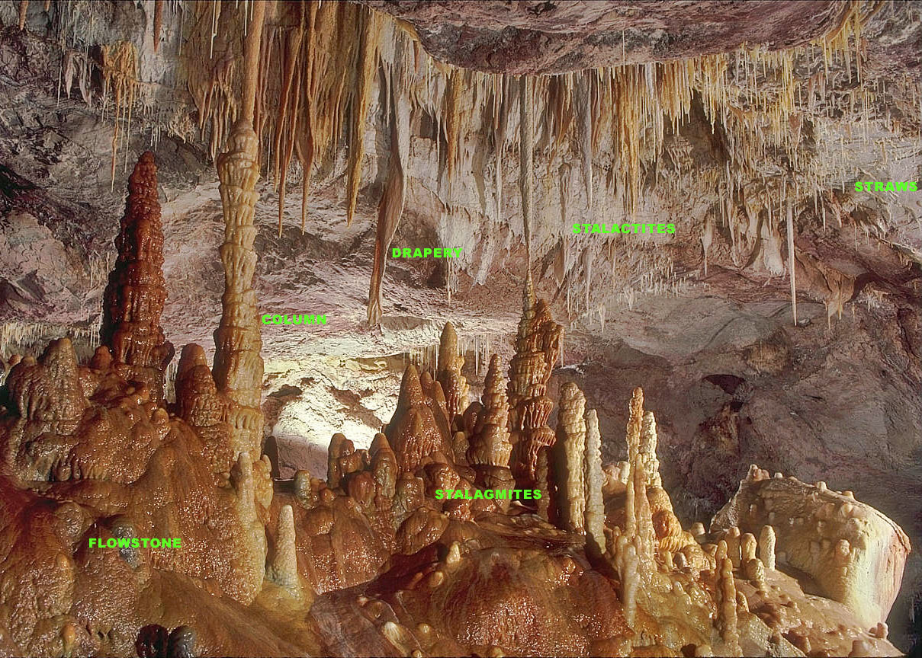
Supervised vis-à-vis Unsupervised Methods
Top-down (supervised learning):
Specify concepts (categories);
Define means to map data to categories
Humans deliberately map their world-view onto the data
Bottom-up (unsupervised learning):
Data-driven; humans provide minimal specifications / inputs
Yields clusters, which may be interpreted as categories
Humans must interpret results in light of their world-view
Image from Wikipedia; see https://en.wikipedia.org/wiki/Stalagmite
Photo by Dave Bunnell / Under Earth Images; https://commons.wikimedia.org/wiki/User:Dave_Bunnell
Shared under Creative Commons Licensing
Bottom-up learning:
Improves as quality / volume of data increases
Less human-labor intensive
Results sometimes strange / hard to interpret
Top-down learning:
Can work with smaller data sets
Very human-labor intensive
Results more closely match human world-view

Slide 4

Preliminaries
Equivalence Classes:
EC1
Contributing Term 1
Contributing Term 2
Contributing Term 3 …
EC2
Contributing Term 1
Contributing Term 2
Contributing Term 3 …
controversy
policy
Document x of Z
Issues
immigration
Trump
100-Day
Jobs
Mexico
energy
Methods of Choice

Slide 5
Supervised Methods (Classification)
Logistic Regression: linear weighting of terms
Support Vector Machine: hyperplanes separate classes
Naïve Bayes: evidence-based classification; must pre-define probabilities for all features and their combinations
Neural Networks: Nonlinear classification, built up by training using a “training corpus” with pre-defined classifications for each document
Deep Learning Neural Networks: More complex classifications; prediction, etc.
Simple Neural Network with Three Output Classes
Output Layer
O₀ … O_{O-1}
Neural networks and deep learning neural networks have become increasingly widespread for NLP applications.
Hidden Layer
H₀ … H_{H-1}
Input Layer
I₀ … I_{I-1}
Figure reproduced from:
Statistical Mechanics, Neural Networks, and Artificial Intelligence
by Alianna J. Maren, Ph.D. (Publication expected 2019). Used with permission.

Slide 6
Unsupervised Methods
K-means: simple vector-similarity clustering of the DSIs
Latent Direchlet Allocation (LDA); Latent Semantic Analysis (LSA): probability-distribution-based grouping of terms into topically-related groups (topic models)
K-Means:
Cluster 1
Doc X
Doc Y
Doc Z …
Cluster 2
Doc A
Doc B
Doc C…
LDA:
Topic 1
Contributing Term 1 (degree of participation 1.1)
Contributing Term 2 (degree of participation 1.2)
Contributing Term 3 (degree of participation 1.3) …
Topic 2
Contributing Term 1 (degree of participation 2.I)
Contributing Term 2 (degree of participation 2.2)
Contributing Term J (degree of participation 2.J) …
Cluster 1
Cluster 2
Topic 1
Topic 2
Doc Z
Doc C
Term 1
Term 1
Doc Y
Doc B
Doc X
Doc A
Term 2
Term 2
Term 3
Term J
In LDA (topic modeling), the same term can participate in multiple topics. However, in clustering, a given document can only be in one cluster.

